Slide 1
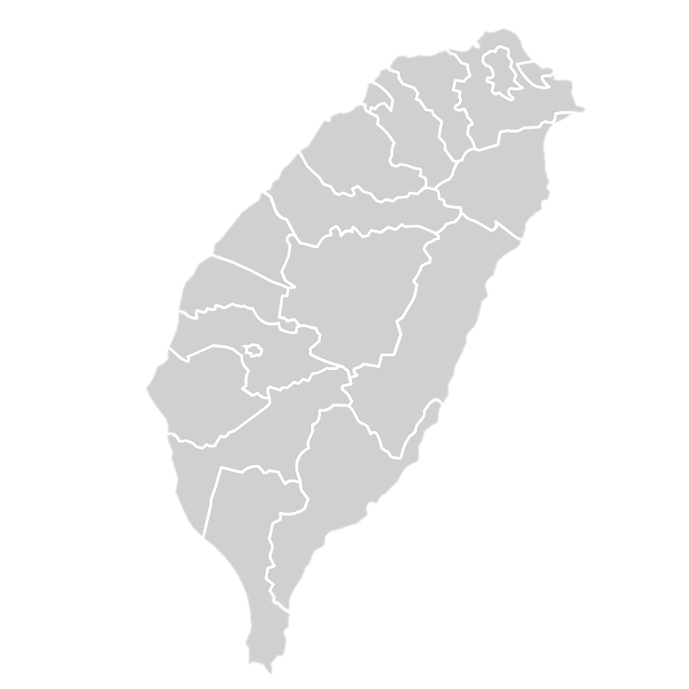
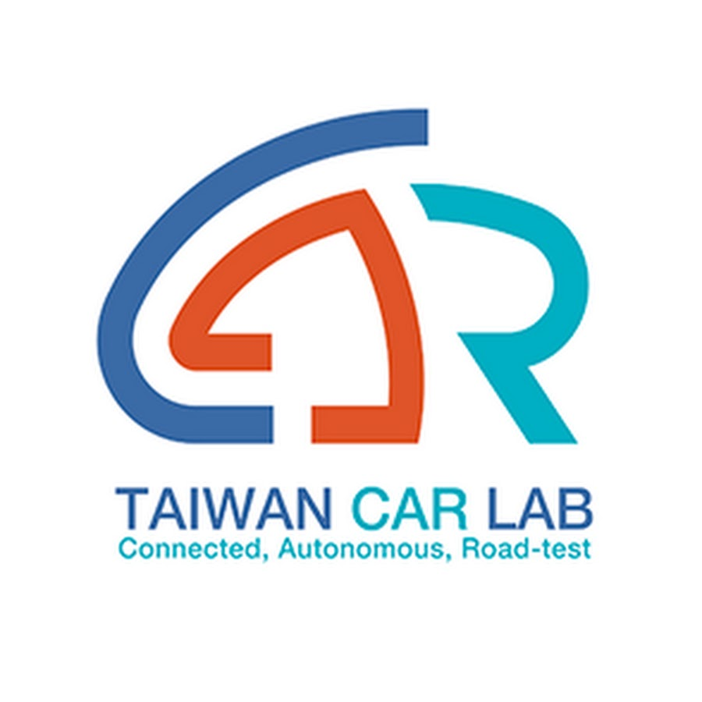


Overview of
Taoyuan Hutoushan Innovation Hub
and Taiwan Car Lab's
Shalun Testing Site

Slide 2



Locations
Taoyuan Hutoushan Innovation Hub
Self-Driving Development Center
Taiwan CAR Lab’s
Shalun Testing Site
Validating real-world tests for self-driving cars from small cars to medium-sized buses

Slide 3
Content
1. Introduction of Taoyuan Hutoushan Innovation Hub &
Testing Environment
2. Introduction of Taiwan CAR Lab's Shalun Testing Site

Slide 4

1. Taoyuan Hutoushan Innovation Hub&
Testing Environment
Own by Taoyuan City Government

Slide 5
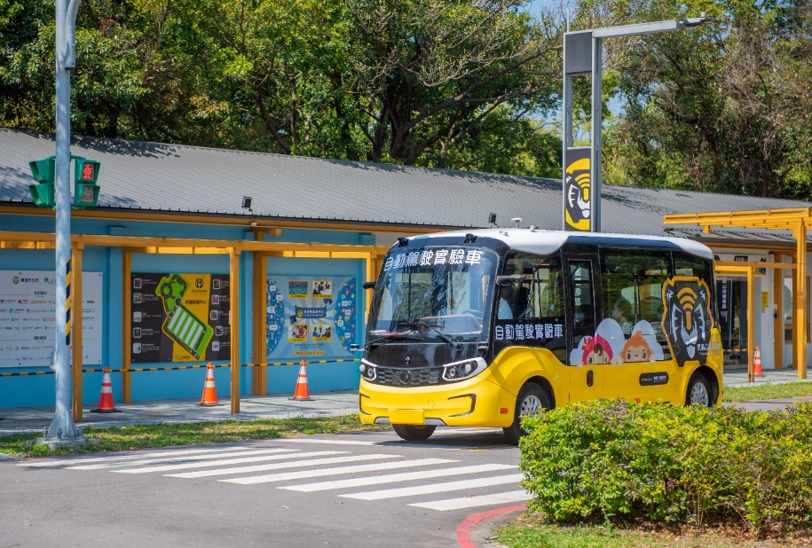
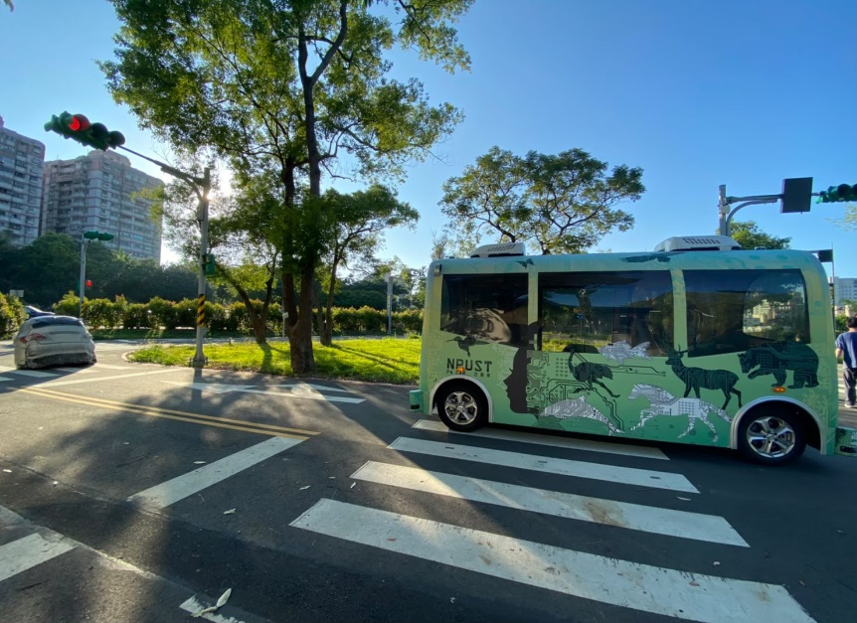
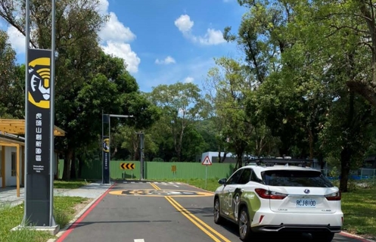
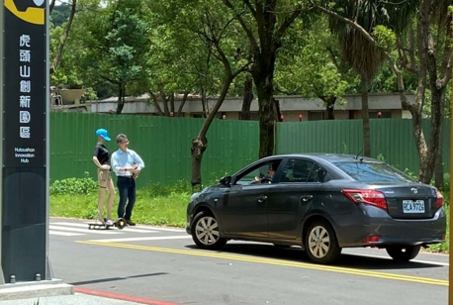
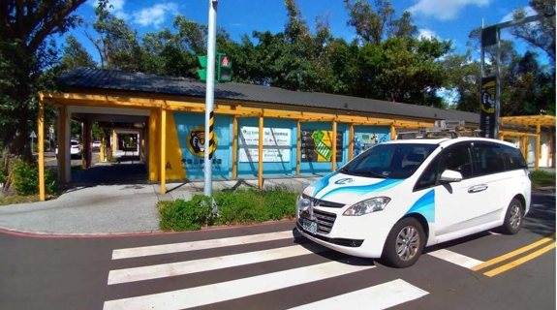
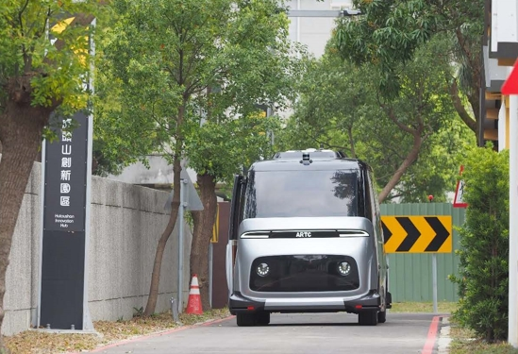
Taoyuan Hutoushan Innovation Hub
1st IoT & Autonomous Vehicle Test Site in Northern Taiwan
Notes:
照片可以更新

Slide 6
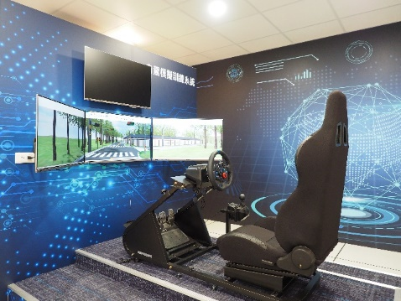
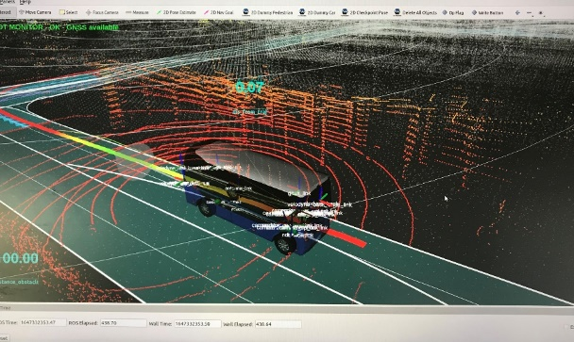
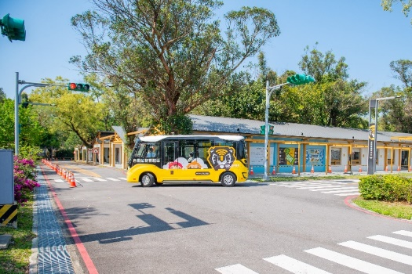
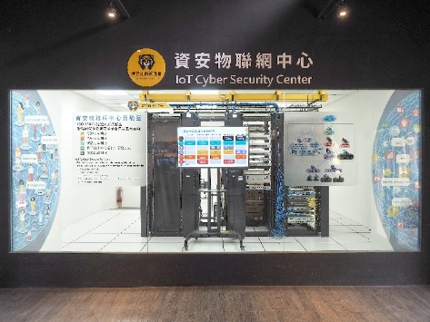
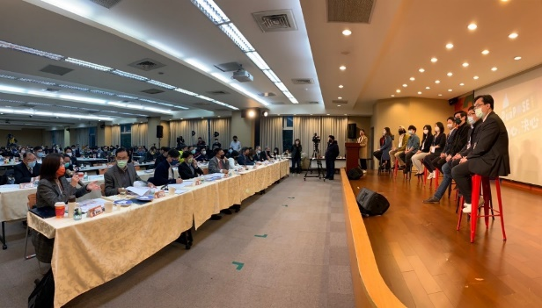
Services
Self-Driving Training
Closed Autonomous Driving Training Area
High Definition Map
Autonomous Driving Simulated System
Smart Roadside Equipment
AI Deep Learning Equipment
5G Environment for C V2X Testing
Startup Counseling
Diverse offices
Various training classes
One-on-one customized counseling
IoV Cyber Security Counseling and Testing
Seminars & matchmakings

Slide 7
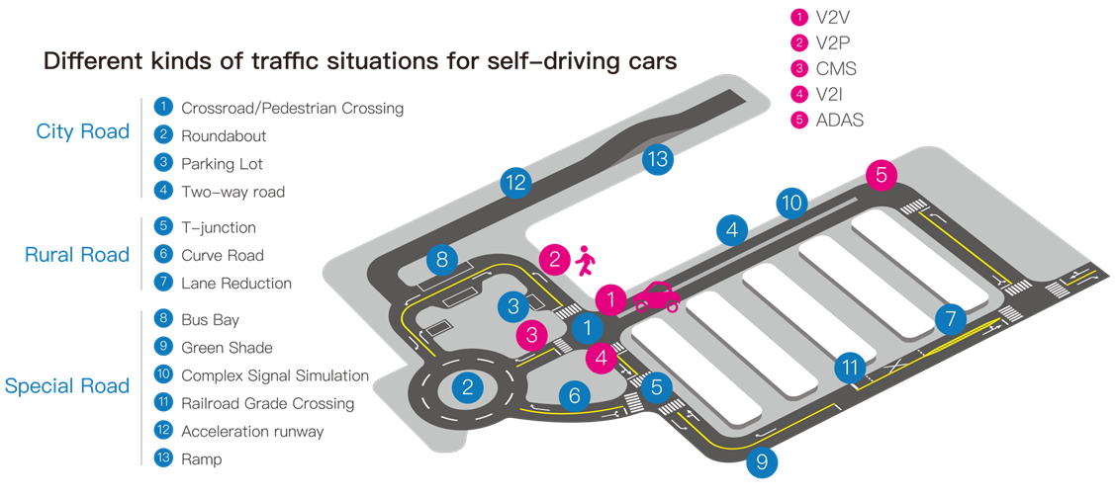
Hutoushan Innovation Hub
13 Traffic situations with 5G C-V2X
Notes:
C-V2X可以多一點解說。

Slide 8
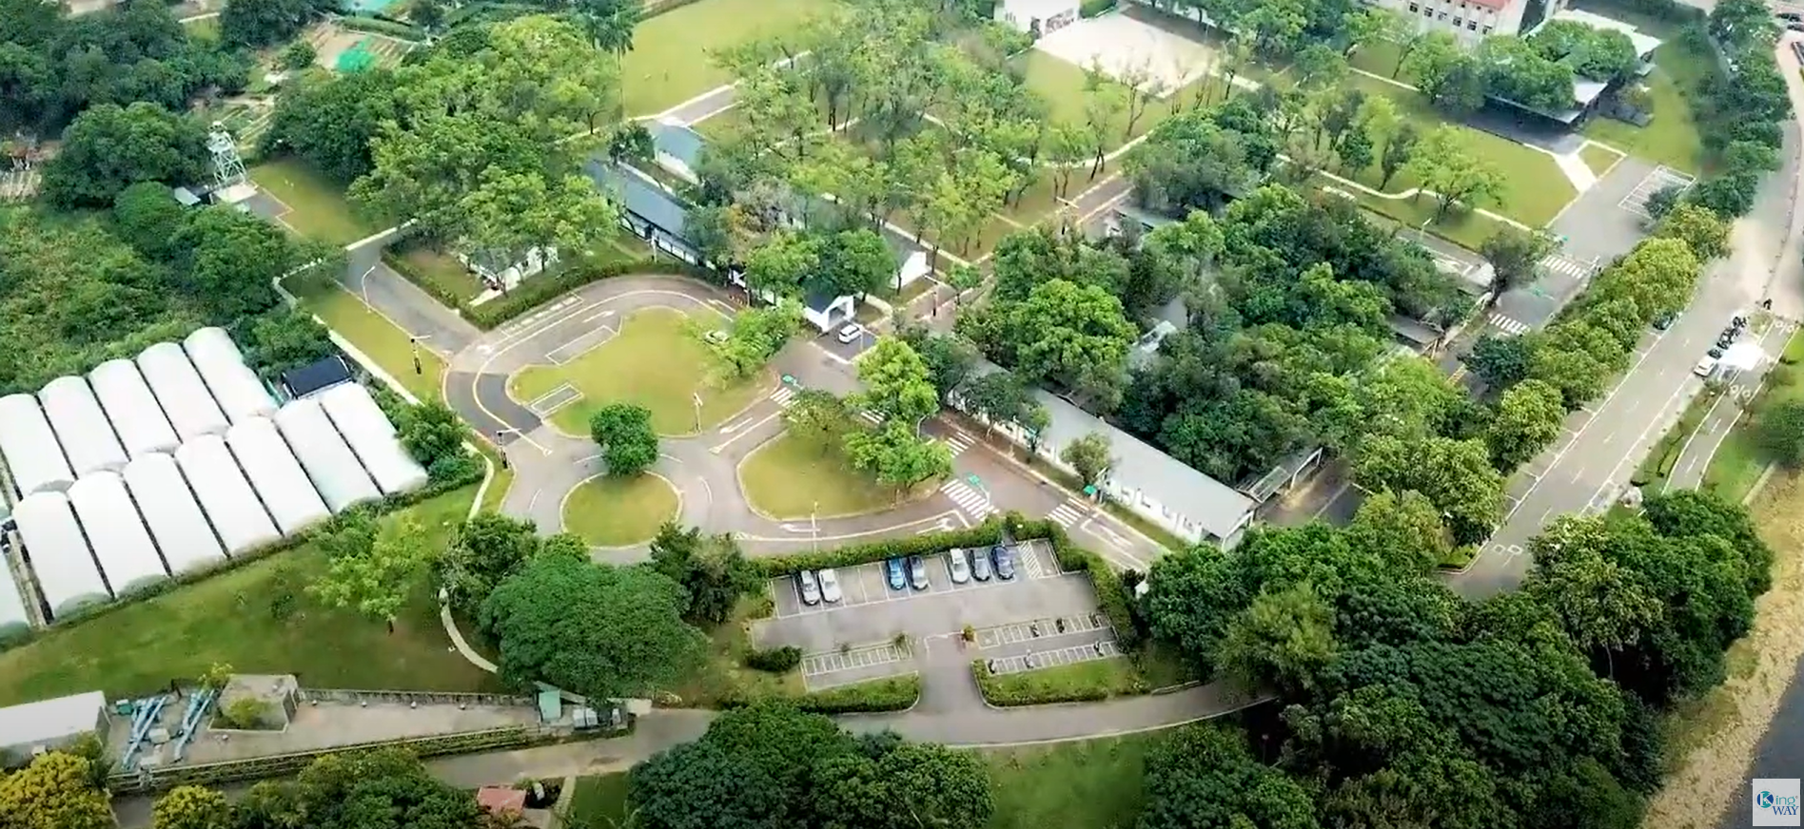
Video 0f
Hutoushan Innovation Hub
https://www.youtube.com/watch?v=xbmvONylL4k

Slide 9

2. Taiwan CAR Lab’s
Shalun Testing Site
Own by National Science and Technology Council

Slide 10
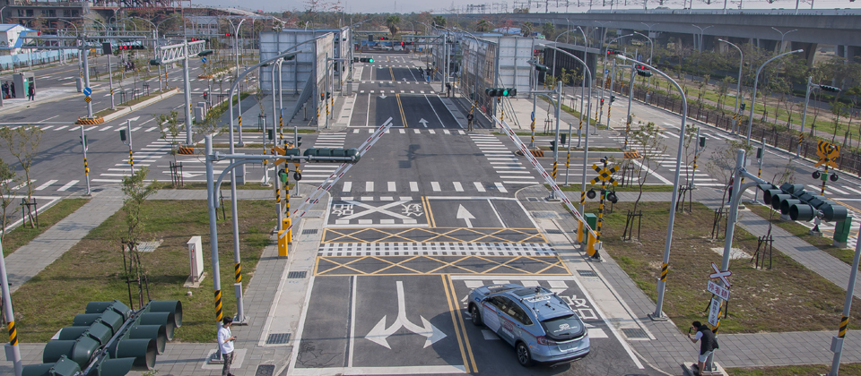
Introduction to Shalun Testing Site
The Shalun testing site spans approximately 2 hectares and facilitates low-speed vehicle tests (0-30 kilometers per hour).It validates real-world performance for self-driving vehicles from small cars to medium-sized buses, including positioning, perception, and decision-making functionalities.

Slide 11
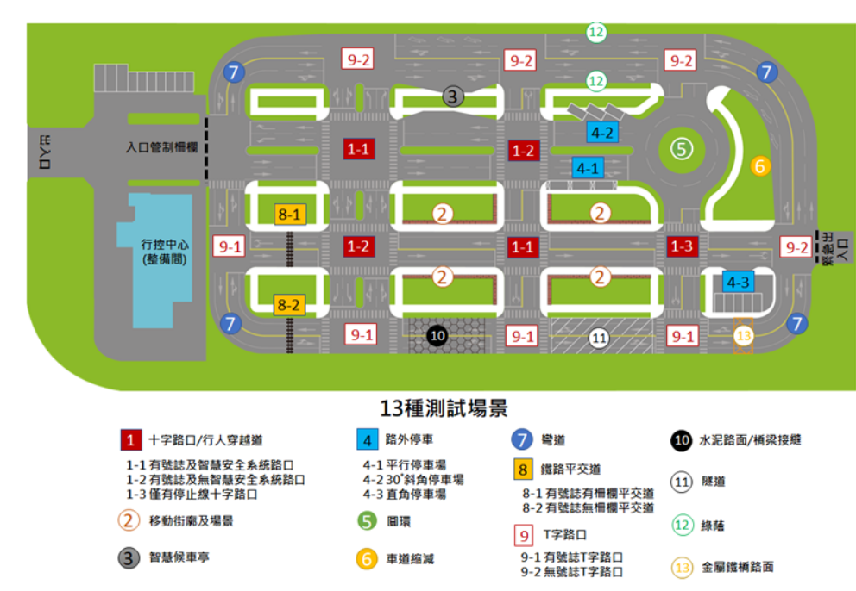
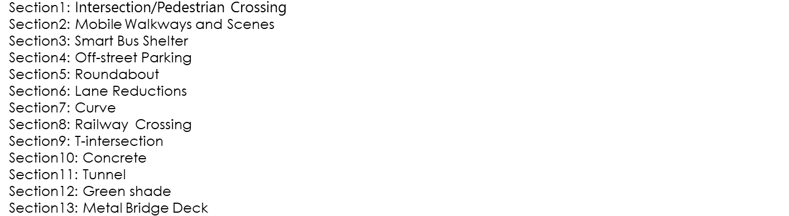
Introduction to Shalun Testing Site

Slide 12

Thank You!
Notes:
This is the end of my presentation. Thank you.

Slide 13
